Slide 1

a Longevity Lifestyle
FDA DISCLAIMER This presentation is not intended for distribution. It contains statements that have not been evaluated by the FDA. Prolon’s products are not designed to diagnose, treat, cure or prevent disease.

Slide 2
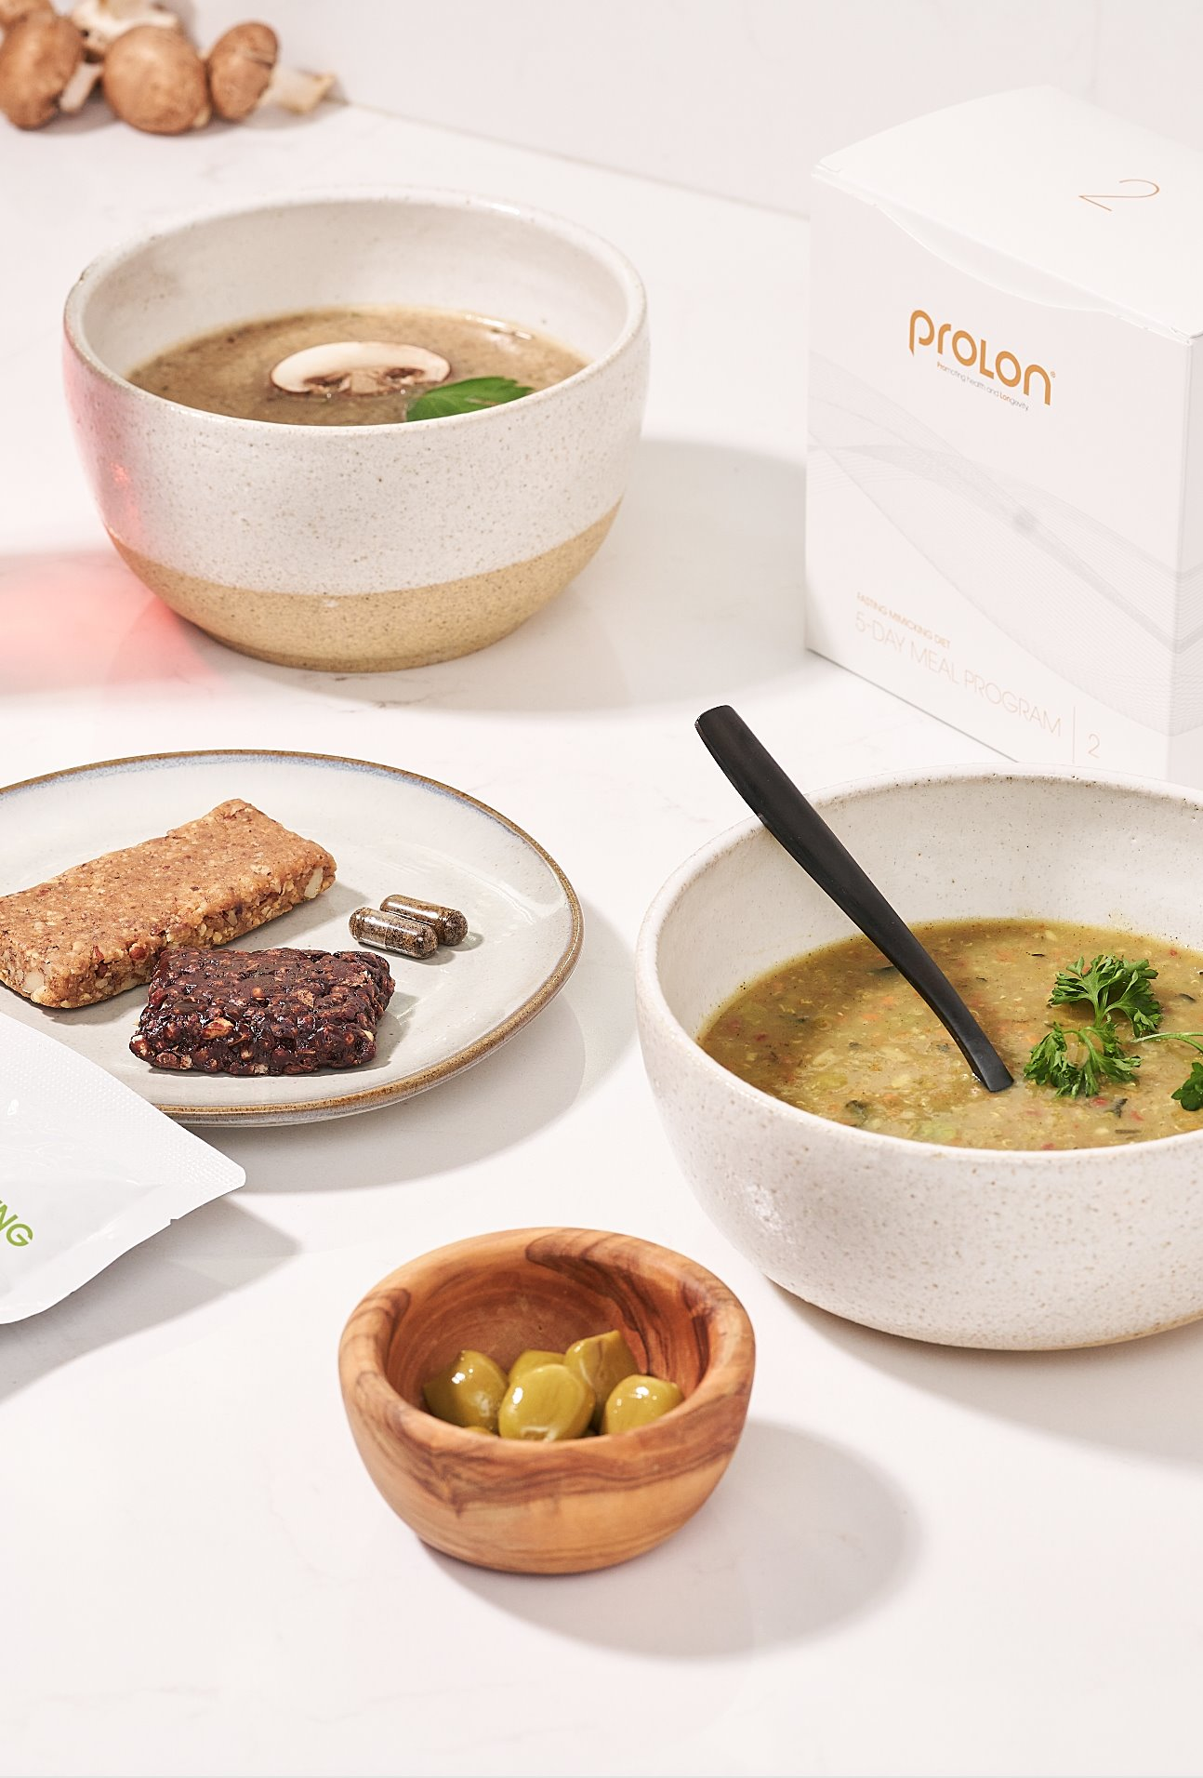
What is Fasting?
Common Definition
Abstinence from all or some kinds of food and drink. This is a traditional water fast.
Physiologic Definition
The switch from burning external glucose for energy to burning internal fatty acids and ketones as main source of fuel; more efficient use of energy. This is the mechanism of ketosis.
Cellular Definition
The absence of triggers of nutrient sensing pathways; stimulation of stress resistance.
This is the goal of the 5-day nutrition program.

Slide 3


Benefits of fasting
Weight loss and fat reduction
Fasting can lead to a calorie deficit, which may help with weight loss. Additionally, during Fasting, the body may utilize stored fat as an energy source, leading to fat reduction.
___________________________________
Improved insulin sensitivity
Fasting can enhance insulin sensitivity, which means your body can use glucose more effectively, reducing the risk of type 2 diabetes. Short-term fasting can lead to increased levels of norepinephrine, which can boost metabolic rate.

Slide 4

Benefits of fasting
Cellular repair and autophagy
Fasting can trigger a process called autophagy, where cells remove damaged components and regenerate, potentially promoting cellular repair and longevity.
___________________________________
Heart health
Fasting may lead to lower blood pressure, Reduced cholesterol levels, and improved heart health markers, lowering the risk of cardiovascular diseases.
___________________________________
Brain health and cognitive function
Some studies suggest that fasting may enhance brain health by promoting the production of brain-derived neurotrophic factor (bdnf), which supports brain function and may protect against neurodegenerative diseases.

Slide 5
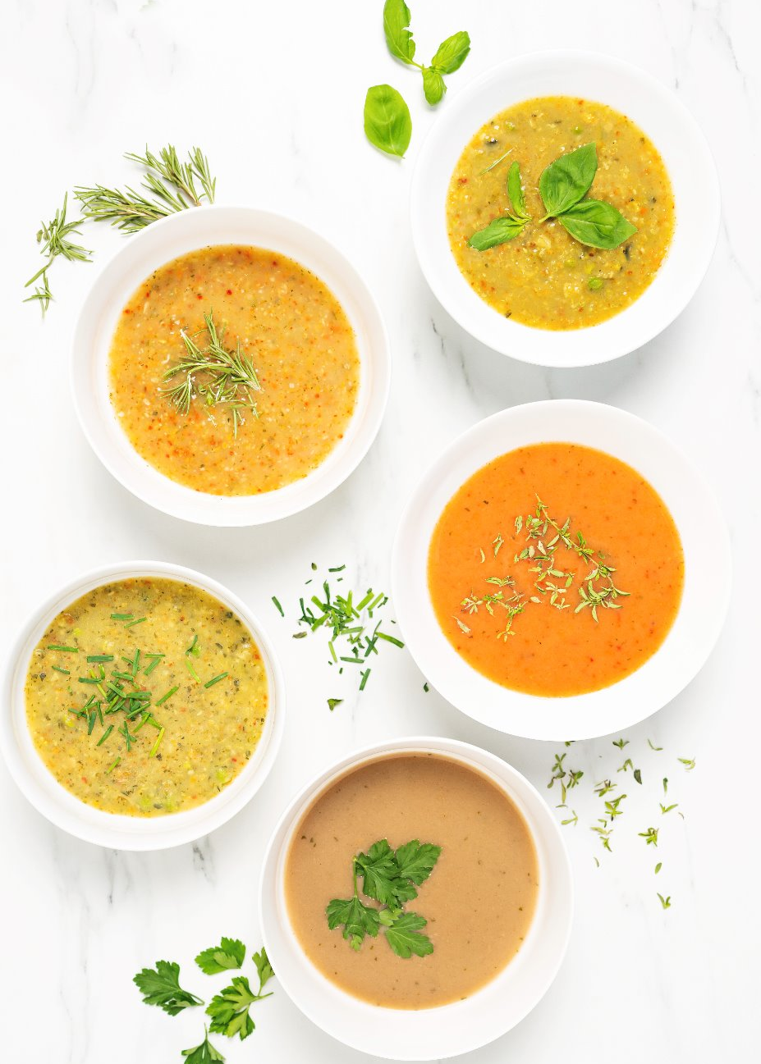
Benefits of fasting
Inflammation reduction
Fasting has been associated with decreased levels of inflammatory markers, potentially benefiting individuals with chronic inflammatory conditions.
___________________________________
Enhanced immune function
Fasting might stimulate the immune system, potentially enhancing its ability to fight off infections and diseases.
___________________________________
Improved digestive health
Giving the digestive system a break during fasting periods can allow it to rest and heal, potentially benefiting individuals with gastrointestinal issues.

Slide 6

Benefits of fasting
Emotional well-being
Some people report experiencing mental clarity, focus, and a sense of discipline during fasting, which can positively impact emotional wellbeing.
___________________________________
Longevity and lifespan extension
Studies in animals have suggested that certain fasting regimens may extend lifespan. However, more research is needed to confirm this effect in humans.

Slide 7
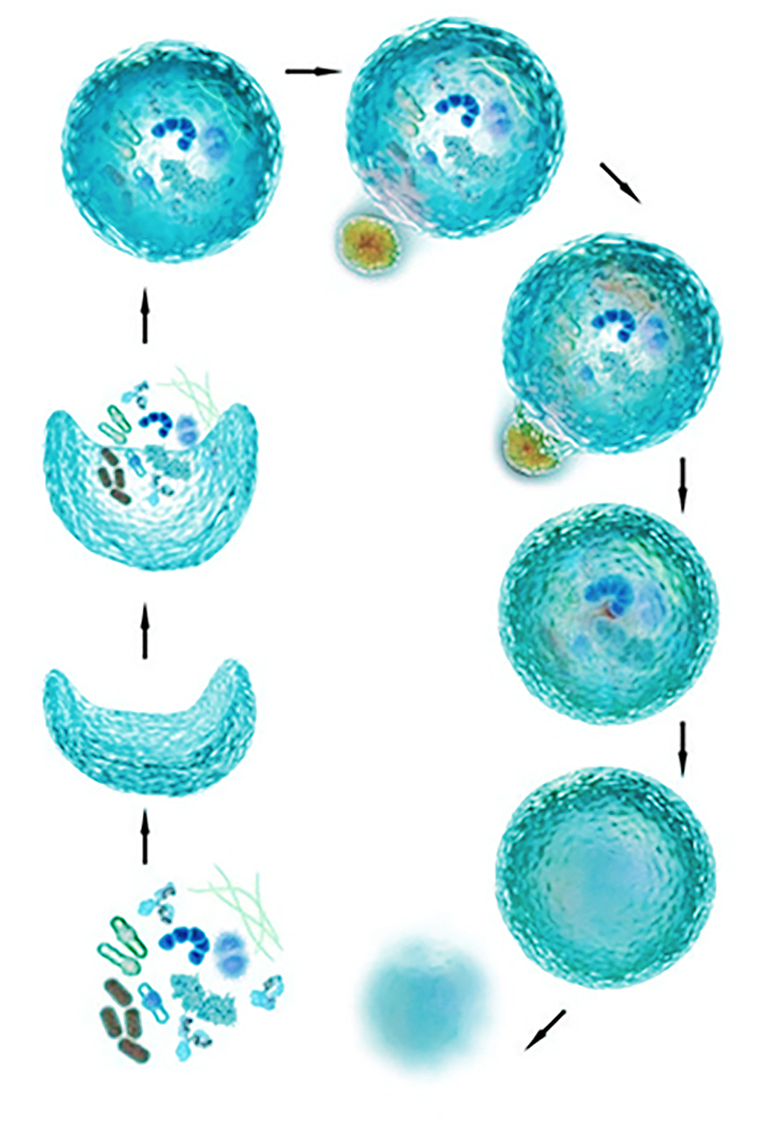
Effect of prolonged fasting
on the cellular level
Autophagy
Poorly functioning organelles - such as mitochondria, and misfolded proteins - are targeted for destruction.
Body’s way of cleaning house - innate recycling.
Important in inflammation, immune function and cellular rejuvenation.
Triggered by prolonged fasting.
2016 NOBEL PRIZE : Yoshinori Ohsumi
”Discovery of Mechanisms for Autophagy”

Slide 8
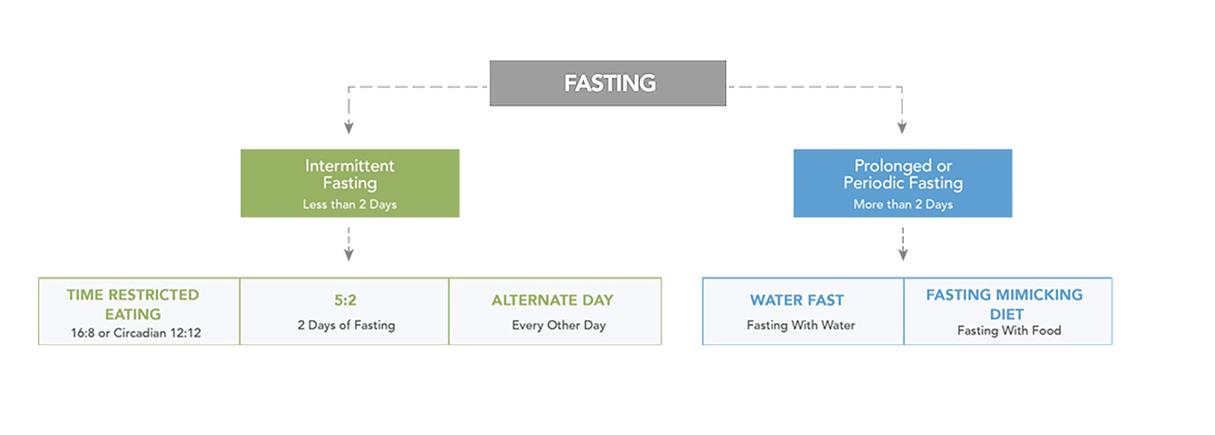
Not all fasting is the same

Slide 9

A prolonged water fast
(4-5 days or longer) can have
some associated challenges
Gallstones
Dehydration
Hypotension
Hypoglycemia
Loss of Muscle Mass
Nutrient Deficiency
Hunger
Prolon was created to enhance:
Adherence
Safety
While still receiving
the health benefits of a prolonged, periodic fast.

Slide 10

Who is Prolon for?
Those who are looking for:
Weight loss
Healthy aging support
Metabolic balance support
Health enthusiasts
Intermittent fasters

Slide 11
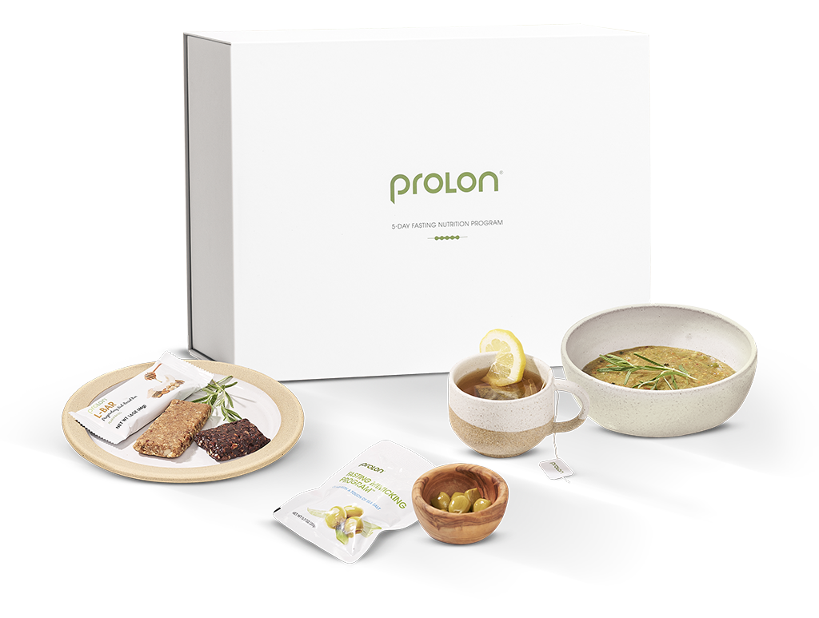
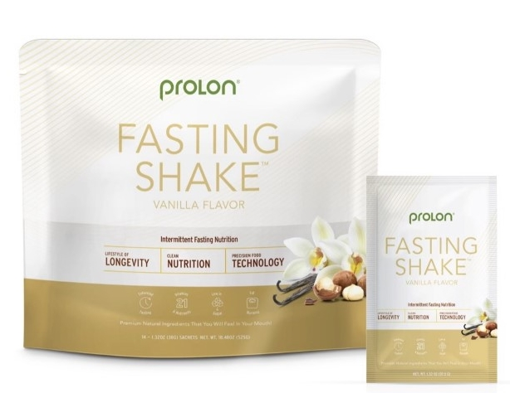
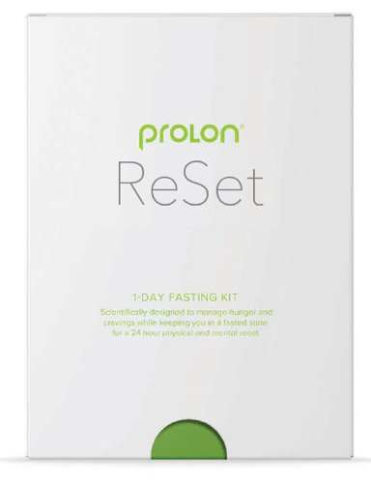
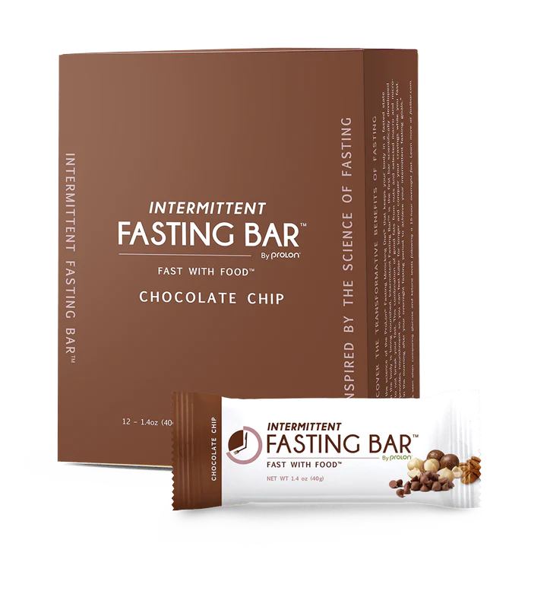
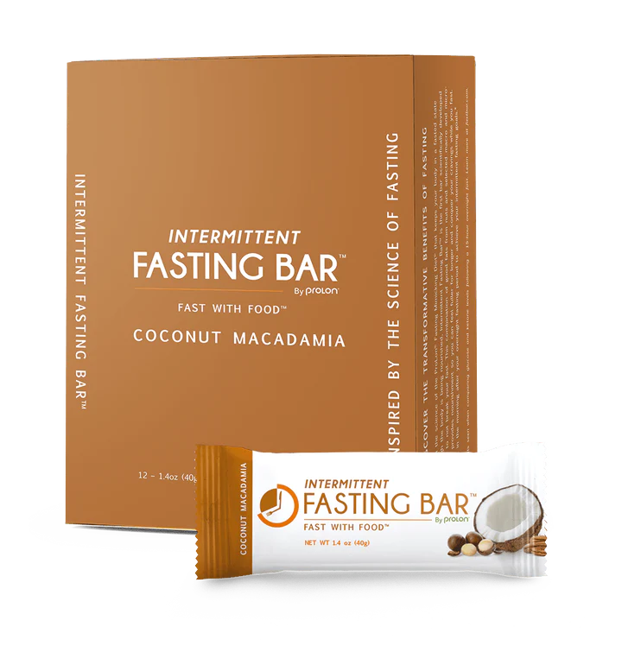
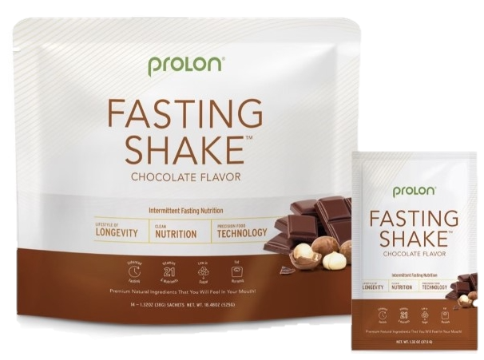
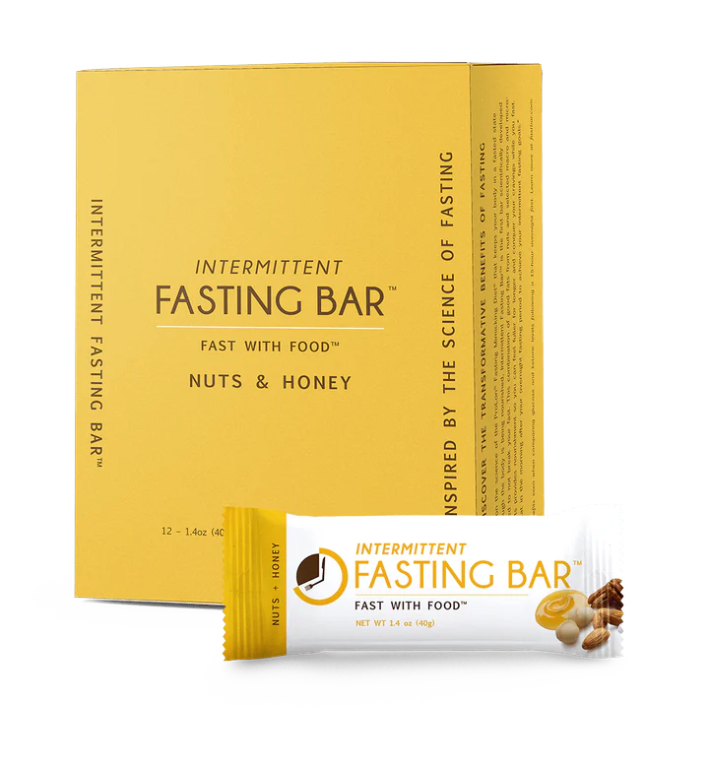
Prolonged Fasting & Intermittent Fasting Products:
ProLon®
Fasting Nutrition Program
Cellular and Metabolic Reset contributing to Healthy Aging
Weight Management
Changing Relationship with Food
Prolon® RESET
1-Day Intermittent Fasting
Reset/balance post few days of unhealthy lifestyle
Twice a week for an intermittent fasting lifestyle (5:2 Fast)
Intro to 5-Day fast
Fasting Bar®
Intermittent Fasting Snack
The smart way to Intermittent Fast. Skip hunger, boost energy so you can fast longer…
Plant Based Protein, Non-GMO, Gluten Free, Keto Friendly
Fasting Shake®
Intermittent Fasting Snack
The smart way to Intermittent Fast
Skip hunger, boost energy so you can fast longer…
Plant Based Protein, Non-GMO, Gluten Free, Keto Friendly
Prolonged Fasting
Intermittent Fasting

Slide 12
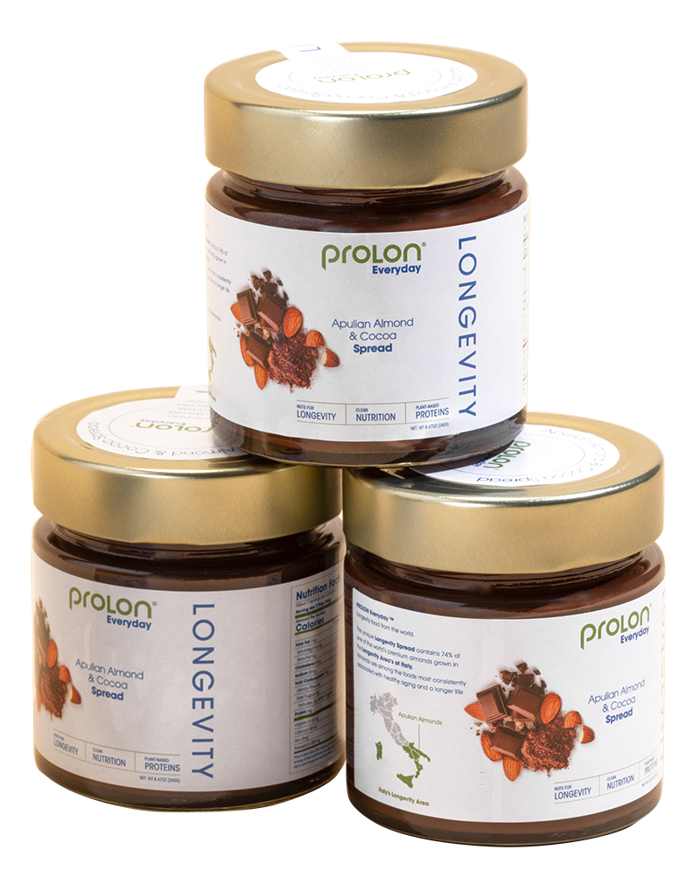
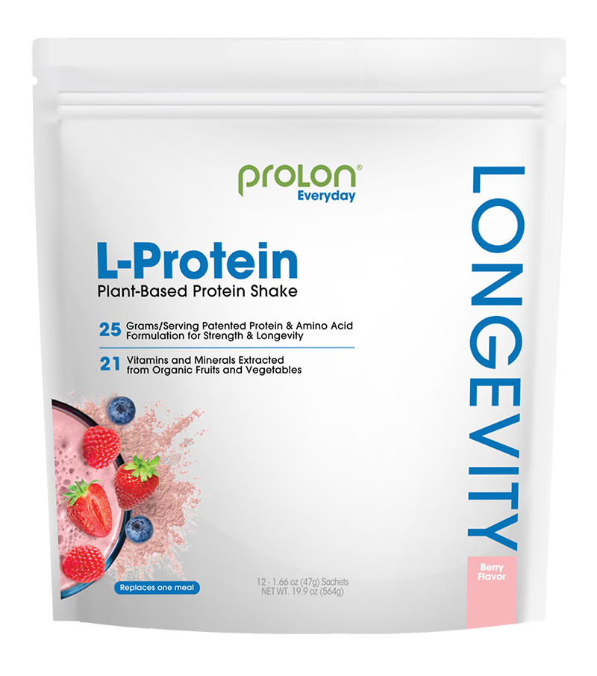
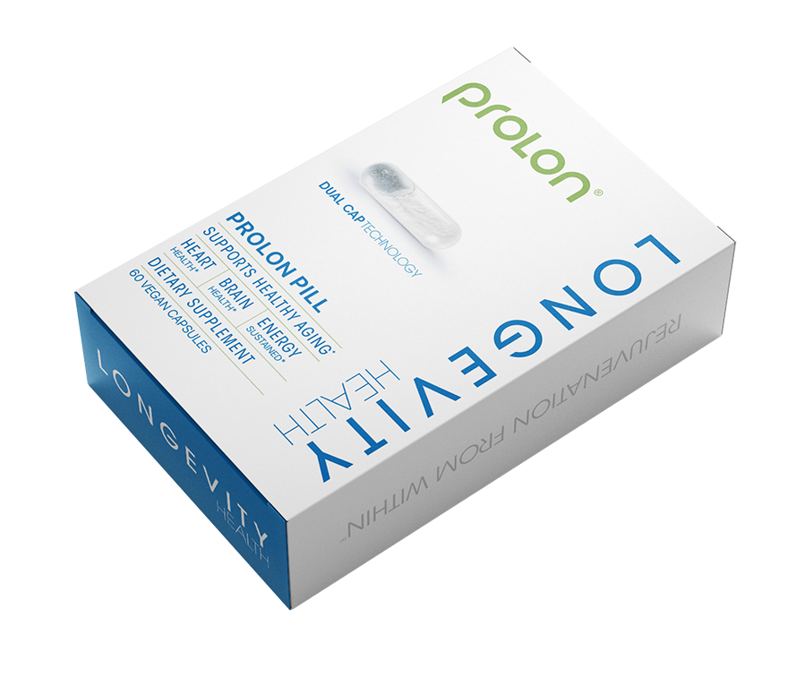
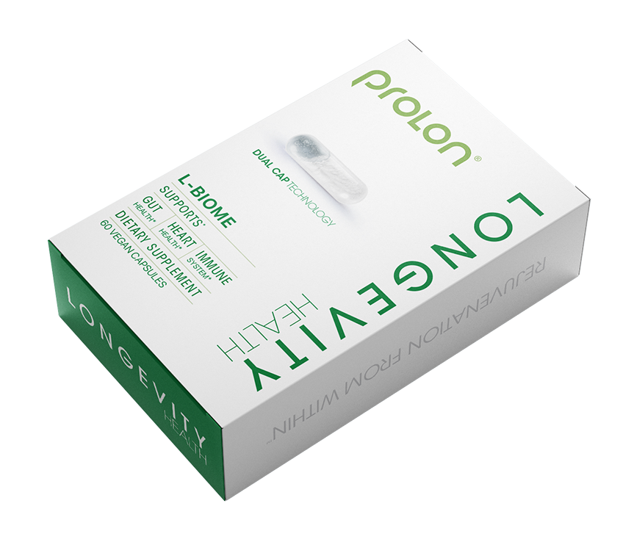
More ways to support fasting and health goals
L-Spread®
Fasting Nutrition Program
74% Apulian almonds, longevity regions of Italy
0% palm oil, gluten-free, soy-free
Dairy-free & vegan
L-Pill®
1-Day Intermittent Fasting
4 Key Ingredients to support healthy aging
Components support heart health, brain health and sustained energy ·
DHA added with dual-cap technology
L-Biome®
Intermittent Fasting Snack
Prebiotic & probiotics from Prolon 5-Day
Designed to preserve the microbiome of fasting
Includes DHA to support brain and cardiovascular health
L-Protein®
Intermittent Fasting Snack
25g plant based protein per serving
Designed to avoid spiking aging pathways including insulin & IGF1
21 vitamins and minerals from organic fruit and vegetables
Everyday Longevity

Slide 13
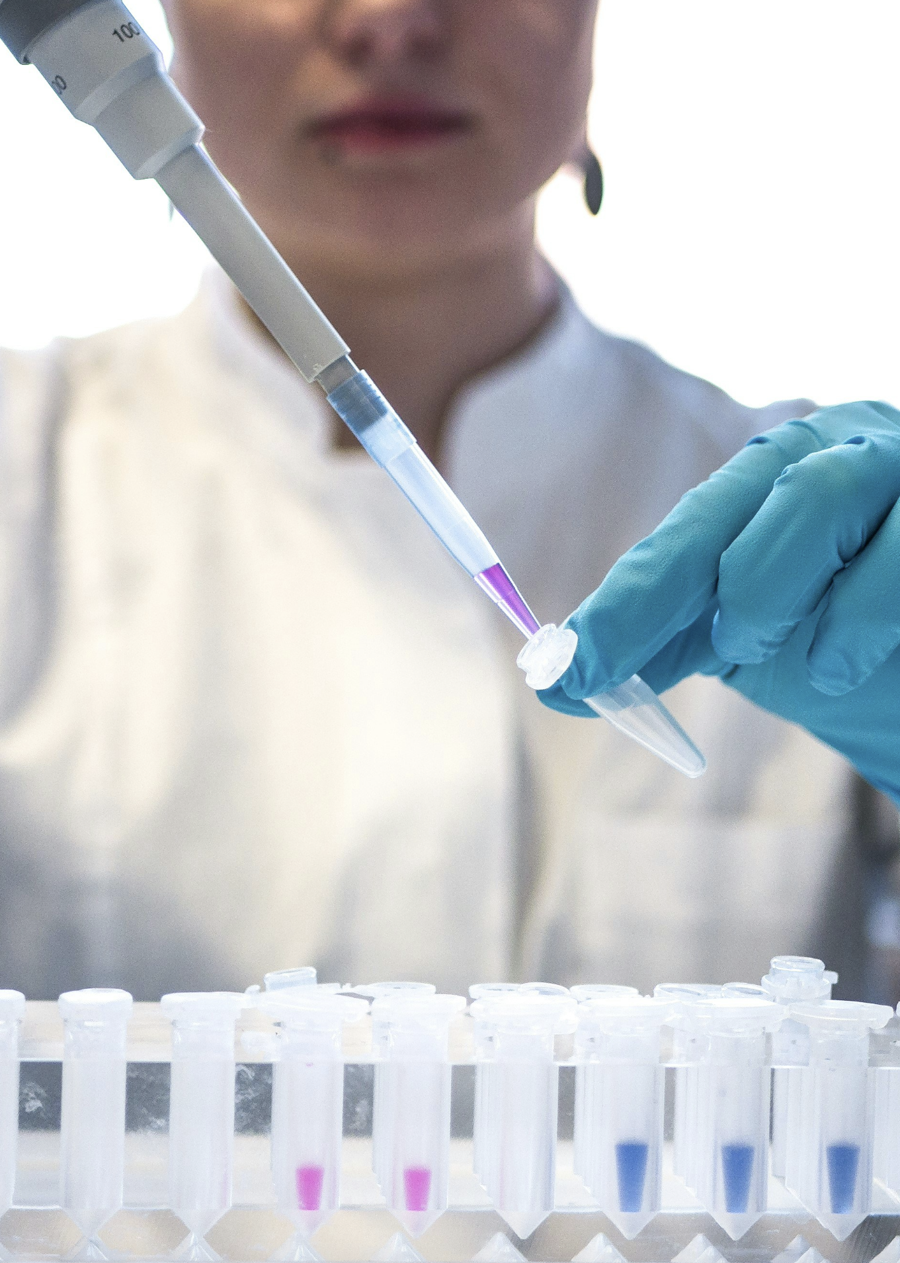
How Was the FMD
Developed?
20+ Years of Research and Development
Foundational preclinical work, completed and pending clinical trials
18+ Prestigious Institutions: University of Southern California, Buck Institute, University of Genoa, IFOM
$48M+ in total research grants
$36M from National Institutes of Health & European Union for aging, fasting, and FMD research
$12M of additional funding for FMD clinical trials
100+ international patents

Slide 14

So how can you fast with food?

Slide 15
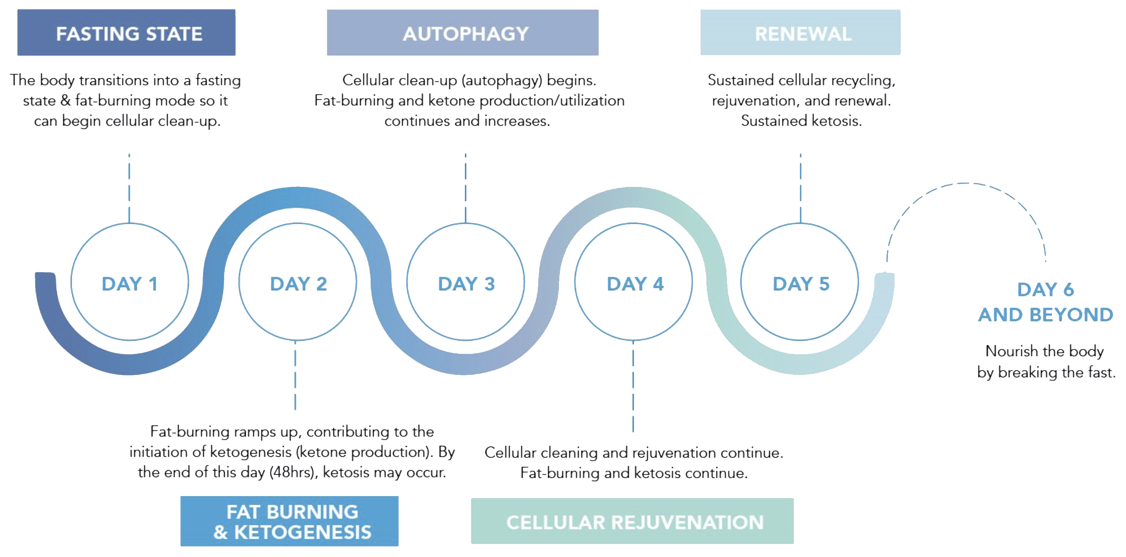
The Prolon 5-day journey

Slide 16
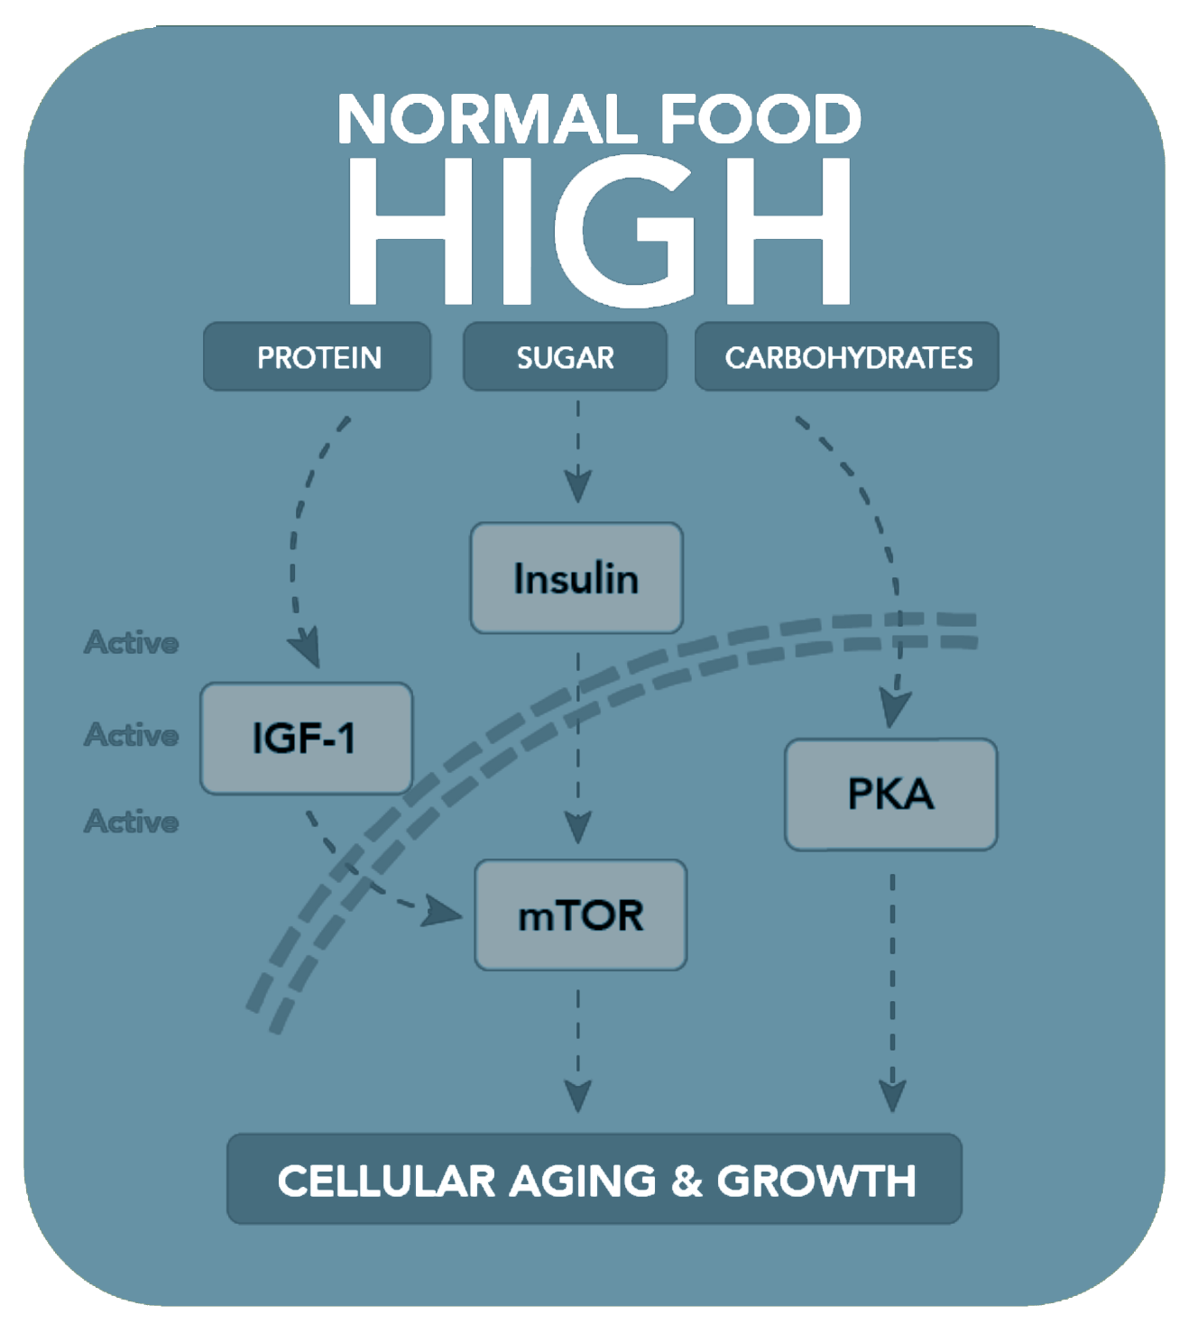
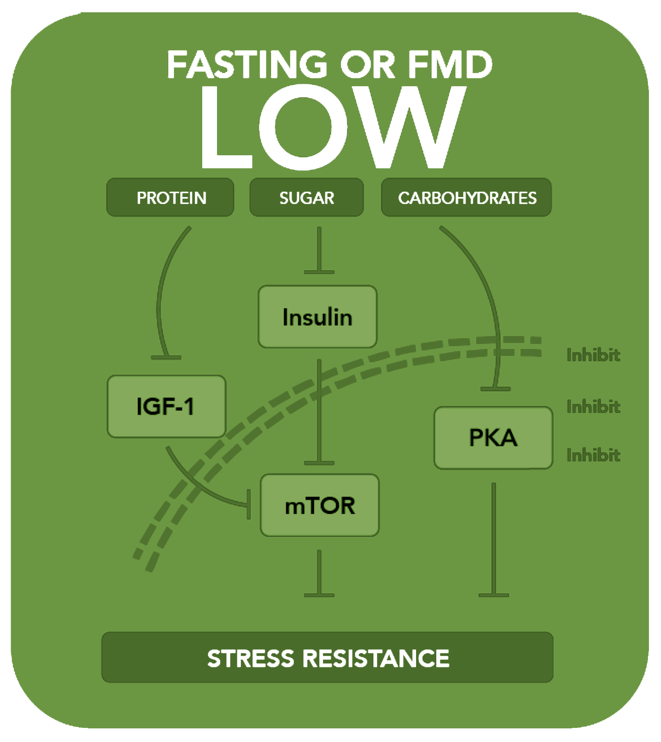
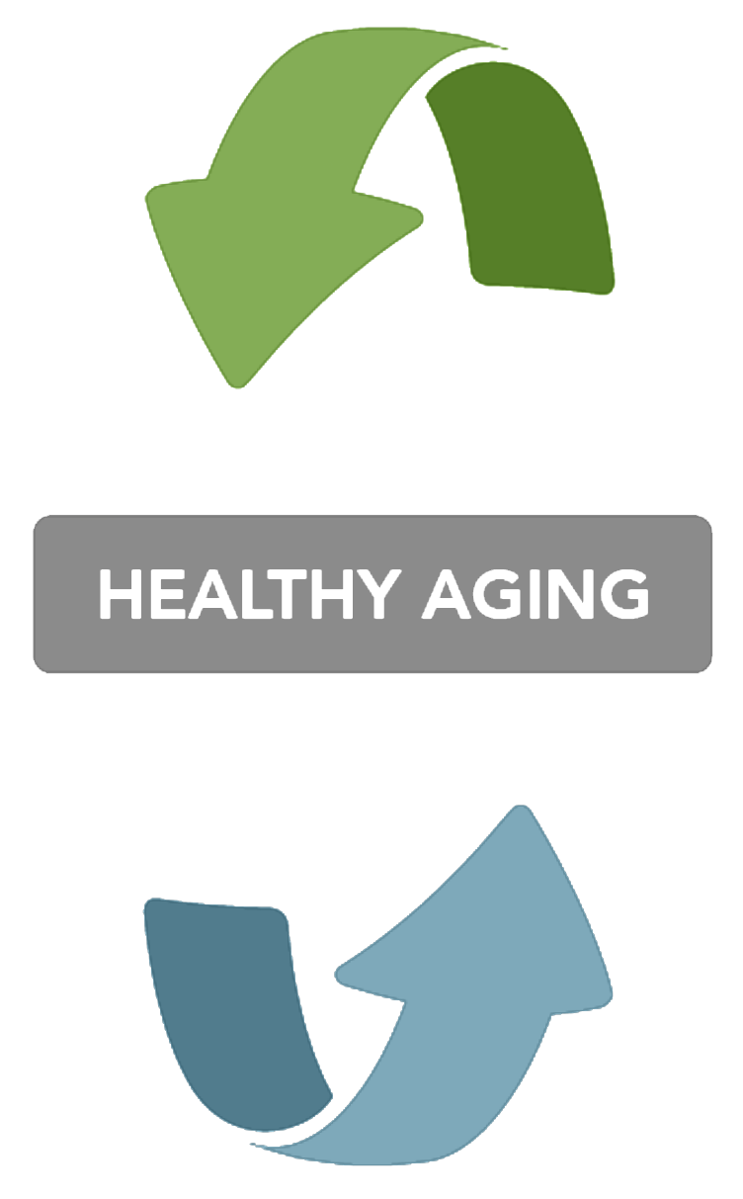
How fasting mimicking works

Slide 17
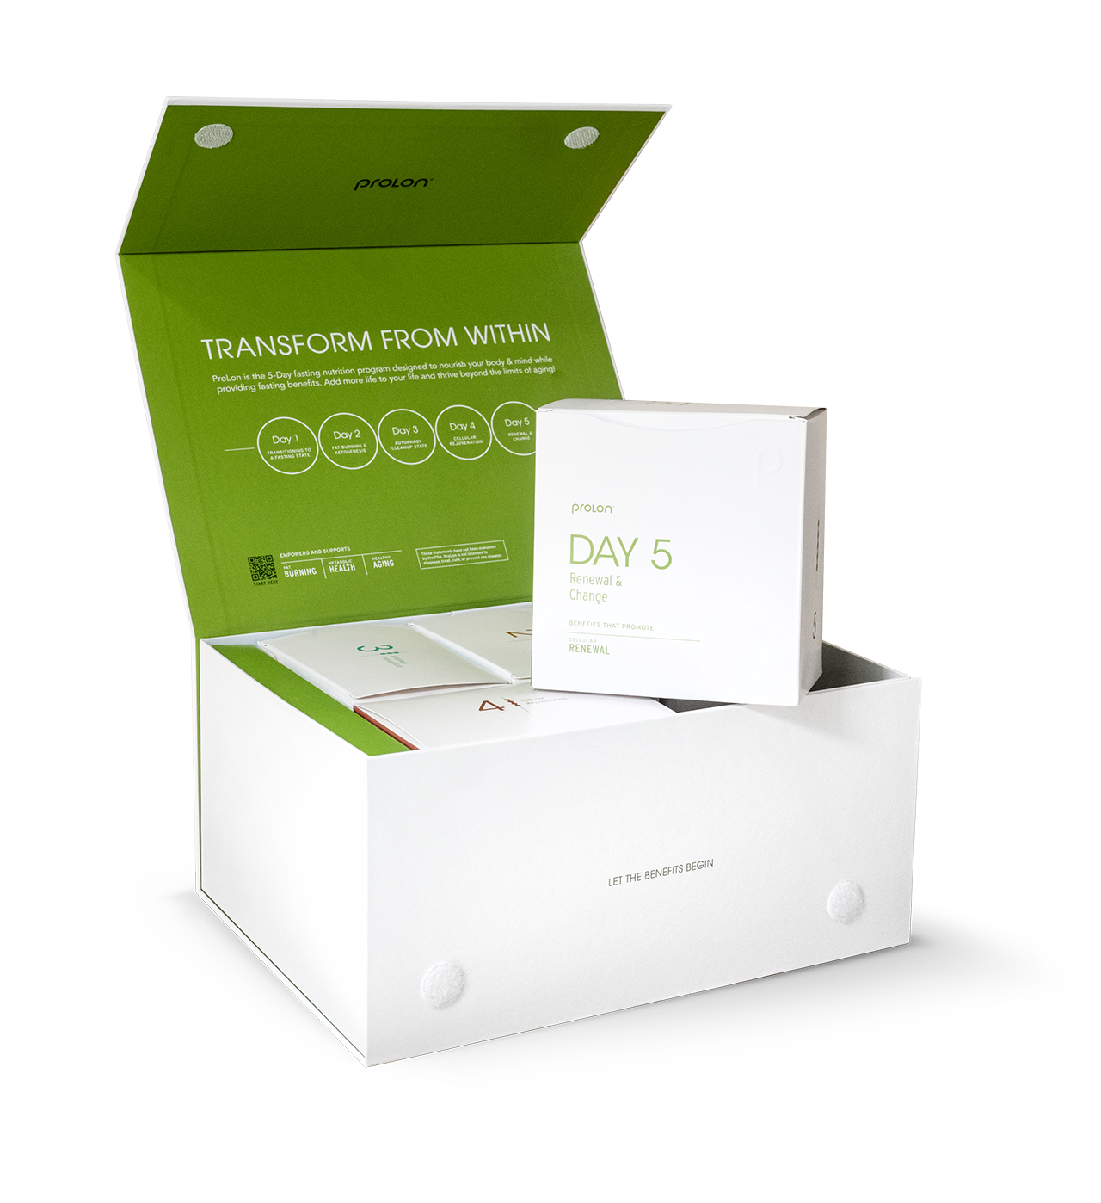
Composition of Prolon
Protein Restriction (9-11%)
Nutritious Nut-Based Fats & Omega-3 Fatty Acids (44-46%)
Complex Carbs & Fiber (43-47%)
Mild Calorie Restriction
(700-1100 Kcal/day)
Mainly plant based, gluten- & lactose-free
Micronutrients & glycerol to nourish the body during fasting

Slide 18
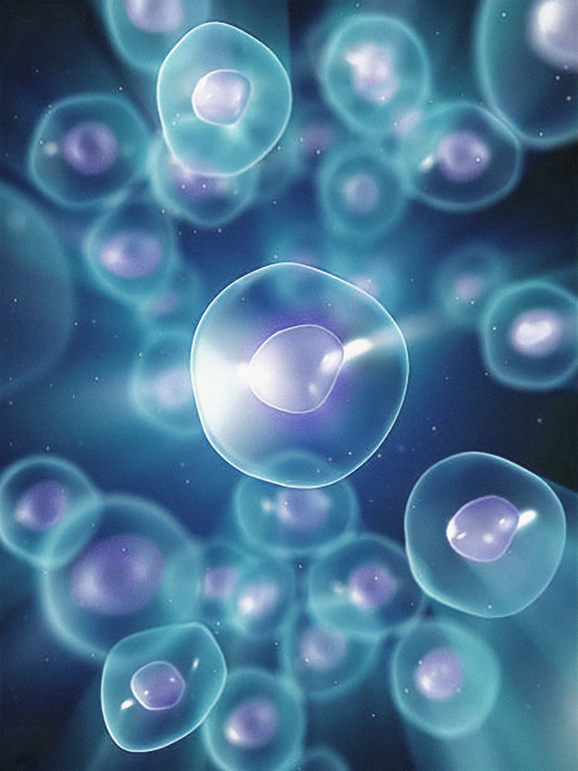
Exciting new study
2.5 years biological age reversal in 1 year (3 cycles)
____________________________________________
Potentially 11 years biological age reversal in 20 years (3 cycles per year)
_______________________________________________
As measured via Yale's biological age formula developed by Dr. Morgan Levine
_______________________________________________
Source A: Nature Comunications
Source B

Slide 19
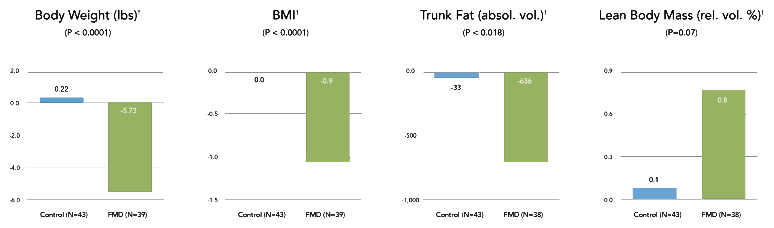
Study Design
Healthy individuals undergoing 3 monthly cycles of Prolon
Anthropometrics - 5.7lb weight loss, decreased BMI, abdominal fat reduction, maintain lean body mass

Slide 20
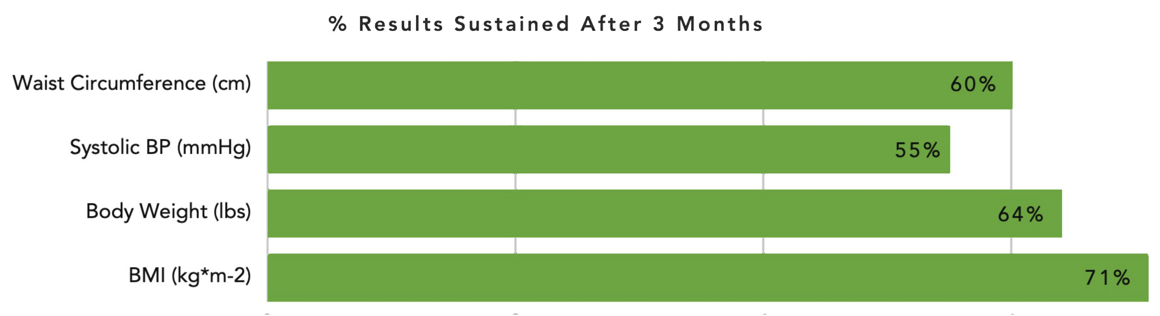
Maintain Results 6 Months after Starting FMD
Source: Wei M, Brandhorst S, et al. Sci Transl Med. Feb 15, 2017;9:1-12

Slide 21
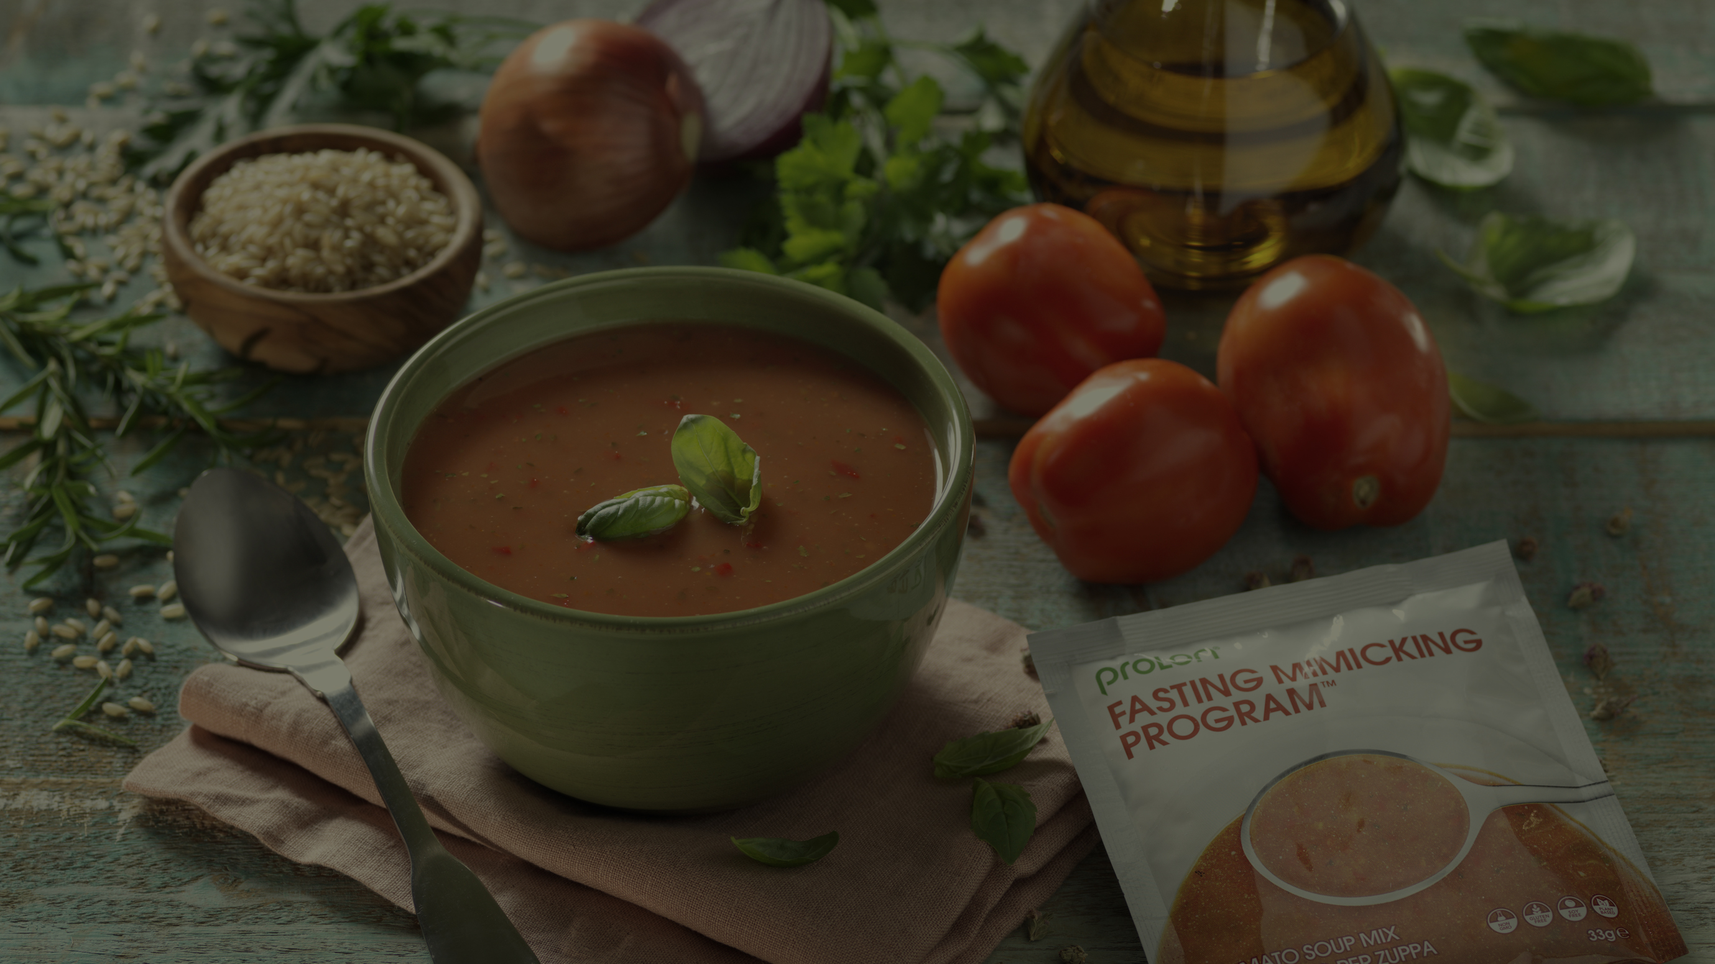
"20 days of Prolon equivalent to 120 days of mediterranean diet for heart health."
___________________________
Mishra et al, Nature, 2024
Source

Slide 22
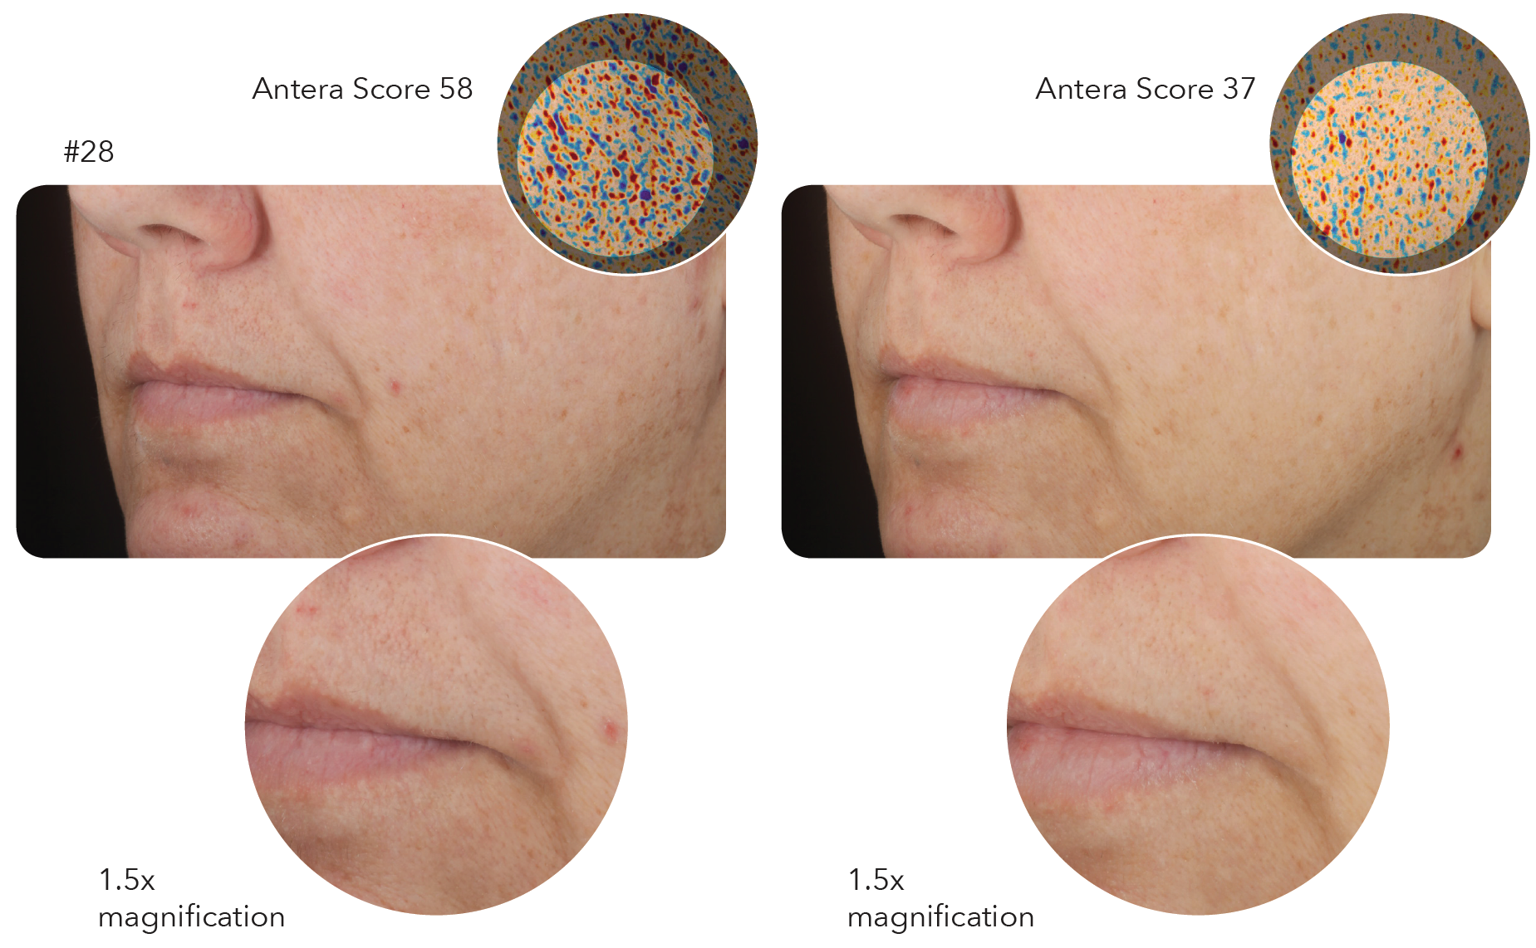
Objective analysis: Skin improvement with Antera + VISIA
Results verified:
36.2% improvement
Clinical Assessment of Skin
Skin smoothness (tactile)-cheeks
Dry fine lines-Global face
Clarity-Global face
Radiance-Global face
Overall appearance-Global face
(Blinded assessment based on modified Griffiths scale assessment after 3 cycles of Prolon)

Slide 23

25% improvement in skin hydration
After completing one round of Prolon's 5-day program

Slide 24

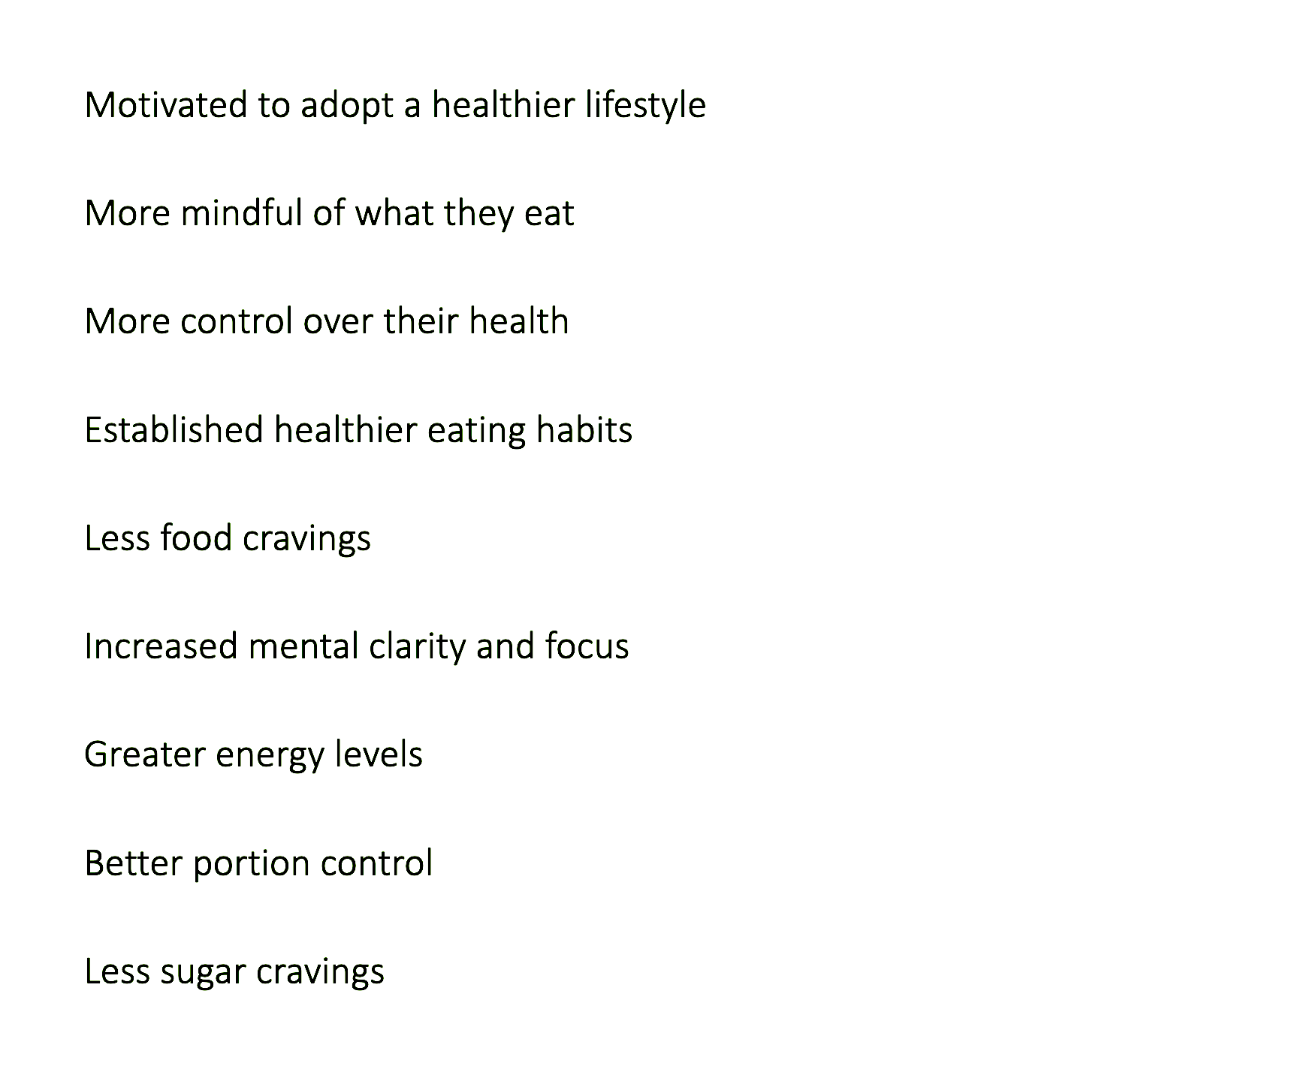
Benefits extend beyond the physical
89% of those surveyed were more motivated
to adopt a healthier lifestyle
*Based on survey of >2000 customers after 1 cycle, conducted by L-Nutra June 2019

Slide 25
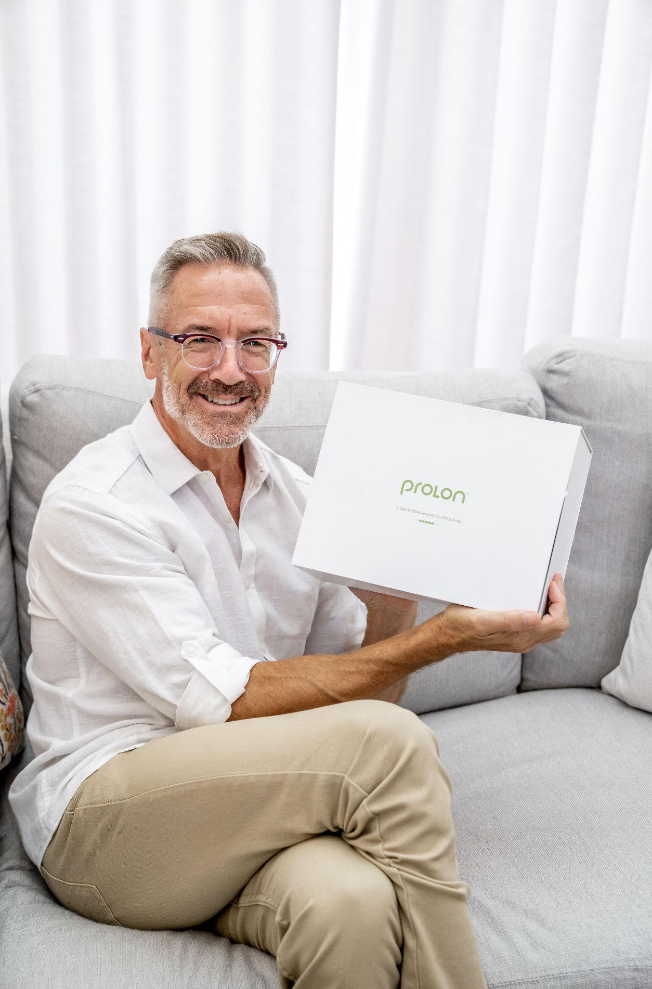
Next Steps
1. Request your kit
___________________________________
2. Create your content
___________________________________
3. Review with your partnership team!
Questions & Content Approvals:
affiliates@l-nutra.com
Notes:
You're ready to create your content! If you haven't yet requested your kit, you can find instructions on how to do so in your email. You can also find the approved claims, best practices, and tips for creating great content. Once you're satisifed with your first pieces of content, be sure to send them to the affiliate team via email. Happy fasting and welcome to the Prolon family.

